Slide 1
2-1/4” MODERN -Self storing
Size range :
-W = 29 to 36-1/2” (1/2” increments)
-H = 68 to 84” (1/8” increments) –
-Kickplate height based on 80” door height = 20”
*if door height changes, the difference will be added or taken away from the kickplate height)
-4 hinges
-Screw covers
-Triple Rubber Box Sweep
-Brass/Silver DX Handle standard (Oil Rubbed Bronze upgrade available)
-standard handle height 41” from the bottom
-Installation Hardware included
-Tempered Glass
-Durable Baked enamel Duracron Finish
-Heavy duty closer
-Available with retractable screen
2-1/4” MODERN-¾ Self Storing
Size range :
-W = Standard sizes 32”, 34”, 36”
-H = 78-½” to 84” (1/8” increments) –
-Kickplate height based on 80” door height = 6-1/2”
*if door height changes, the difference will be added or taken away from the kickplate height)
-4 hinges
-Screw covers
-Triple Rubber Box Sweep
-Brass/Silver DX Handle
-standard handle height 41”
-Installation Hardware included
-Tempered Glass
-Durable Baked enamel Duracron Finish
-Heavy duty closer
-NOT available with retractable screen
2-1/4” MODERN-Deluxe Self Storing
Size range :
-W = 30 to 36-1/2” (1/2” increments)
-H = 78-½” to 84” (1/8” increments)
-Kickplate height based on 80” door height = 6-1/2”
*if door height changes, the difference will be added or taken away from the kickplate height)
-4 hinges
-Screw covers
-Triple Rubber Box Sweep
-Brass/Silver DX Handle
-standard handle height 41”
-Installation Hardware included
-Tempered Glass
-Durable Baked enamel Duracron Finish
-Heavy duty closer
-Available with retractable screen

Slide 2
2-1/4 MODERN-Full View
Size range :
-W = 30 to 36 ½” (1/2” increments)
-H = 78-½” to 84” (1/8” increments)
-5 hinges
-Screw covers
-Triple Rubber Box Sweep
-Brass/Silver DX Handle
-standard handle height 41”
-Installation Hardware included
-Tempered Glass
-Durable Baked enamel Duracron Finish
-Heavy duty closer
No screen
2-1/4” MODERN 3-Lite Self storing
Size range :
-W = 30 to 36-1/2” (1/2” increments)
-H = 78-½” to 84” (1/8” increments)
-Kickplate height based on 80” door height = 8”
*if door height changes, the difference will be added or taken away from the kickplate height)
-5 hinges
-Screw covers
-Triple Rubber Box Sweep
-Brass/Silver DX Handle
-standard handle height 41”
-Installation Hardware included
-Tempered Glass
-Durable Baked enamel Duracron Finish
-Heavy duty closer
-Available with retractable screen
2-1/4” MODERN 1-Lite
Size range :
-W = 30 to 36-1/2” (1/2” increments)
-H = 78-½” to 84” (1/8” increments)
-Kickplate height based on 80” door height = 8”
*if door height changes, the difference will be added or taken away from the kickplate height)
-5 hinges
-Screw covers
-Triple Rubber Box Sweep
-Brass/Silver DX Handle
-standard handle height 41”
-Installation Hardware included
-Tempered Glass
-Durable Baked enamel Duracron Finish
-Heavy duty closer
-Comes with interchangeable screen unless specified “no screen” with order

Slide 3
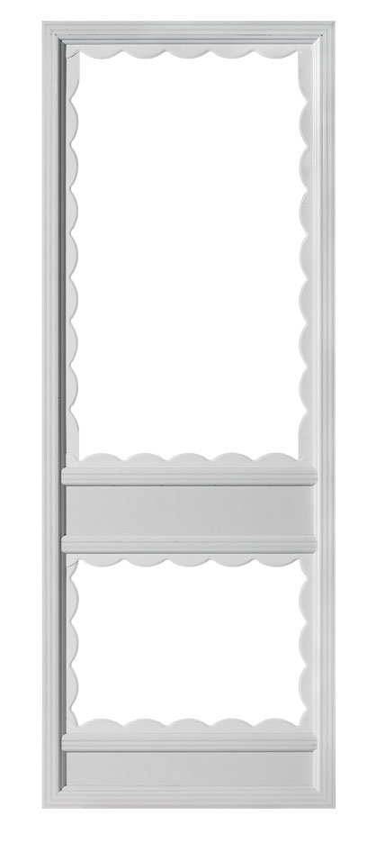
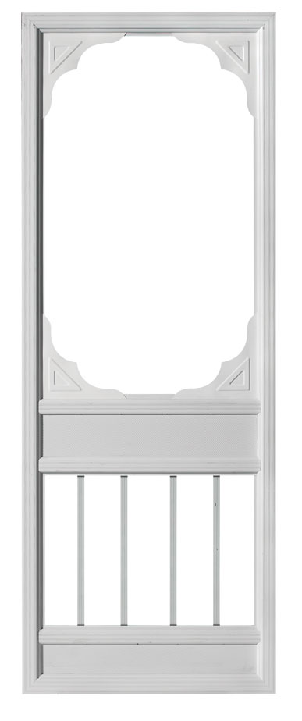
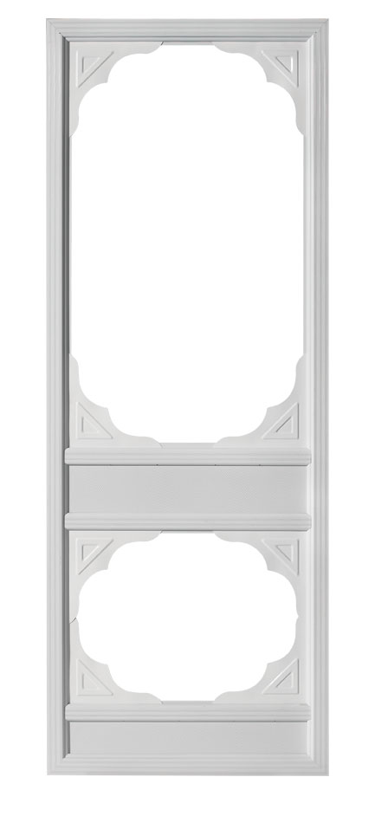
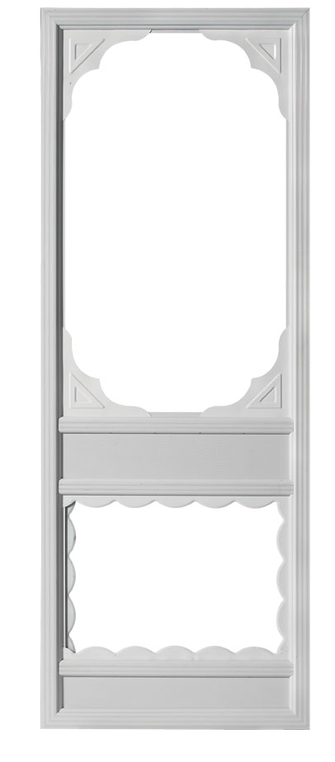
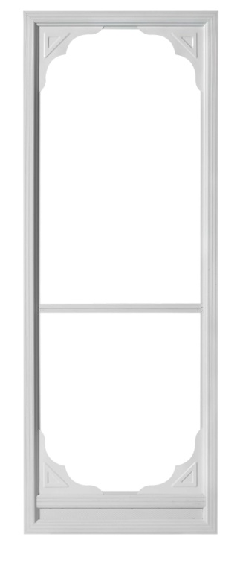
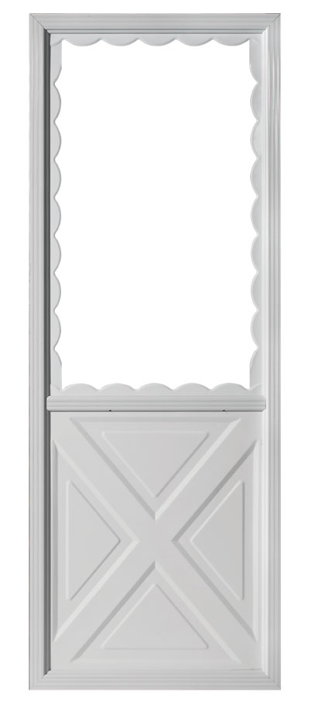
2” Classic-Victorian Collection
Size range :
-W = 30 to 36-1/2” (1/2” increments)
-H = 78-½” to 84” (1/8” increments)
-4 hinges
-Screw covers
-Triple Rubber Box Sweep
-Brass/Silver DX Handle
-standard handle height 41”
-Installation Hardware included
-Tempered Glass
-Durable Baked enamel Duracron Finish
-Heavy duty closer
*All Victoria series doors have interchangeable screens on top, except # 5 which operates like a Deluxe Self
Storing door.
Victoria 1
Victoria 2
Victoria 3
Victoria 4
Victoria 5
CLASSIC- Colonial
Size range :
-W = 30 to 36-1/2” (1/2” increments)
-H = 79 ¼”to 84” (1/8” increments)
-4 hinges
-Screw covers
-Triple Rubber Box Sweep
-Brass/Silver DX Handle
-standard handle height 41”
-Installation Hardware included
-Tempered Glass
-Durable Baked enamel Duracron Finish
-Heavy duty closer
-Colours available- WHITE and BROWN only
*Colonial doors have interchangeable screens on top

Slide 4
VINYL STORM DOORS
MAXVIEW
Size range :
-W = 29 to 36-1/2” (1/2” increments)
-H = 68 to 84” (1/8” increments) –
-5 hinges
-Screw covers and Back Up angle
-Triple Rubber Box Sweep
-Brass/Silver Elite Lever Handl standard (Oil Rubbed Bronze upgrade available) *DX not available
-standard handle height 41” from the bottom
-Installation Hardware included
-Tempered Glass
-White Standard-optional Euro Finish paint available- Exterior / white interior (standard and custom colours available)
-Heavy duty closer
PRESTIGE
Size range :
-W = 29 to 36-1/2” (1/2” increments)
-H = 68 to 84” (1/8” increments) –
-Retractable Screen hidden in top rail
-Decorative SDL rail
-5 hinges
-Screw covers and Back Up angle
-Triple Rubber Box Sweep
-Brass/Silver Elite Lever Handl standard (Oil Rubbed Bronze upgrade available) *DX not available
-standard handle height 41” from the bottom
-Installation Hardware included
-Tempered Glass
-White Standard-optional Euro Finish paint available- Exterior / white interior (standard and custom colours available)
-Heavy duty closer

